Slide 1
DATA MINING FINAL PROJECT
PRESENTED BY: ABHIJEET SUDHAKAR, VINUSHREE NAGRAJ, POORNIMA MURALIDHARAN, NIKHIL S THORAT

Slide 2

OUTLINE
INTRODUCTION
Data Mining Definition
Dataset and Business Problem
DATA CLEANUP
Checking null values and imbalance in the data.
Checking and fixing data types
Removing unnecessary columns and negative values
Detecting and removing Anomalies or Outliers
DATA DISCOVERY : Exploratory data analysis
Histograms
Pie chart
Distribution plots
Correlation plots
DATA MODELLING
Model : Logistic Regression
DATA OPTIMIZATION : Predictive Modelling
Feature Selection : Forward and Backward Method
Feature Engineering: One hot Encoding
Complex Algorithms: Random Forest Classifier & Gradient Boosting Classifier
Metrics: Confusion Matrix, Model.Score and Training time
DATA STORYTELLING
Data Visualization using Dashboard

Slide 3
DATA MINING DEFINITION
PROCESS LARGE RAW DATASETS INTO USEFUL INFORMATION
CHECK FOR PATTERNS IN DATA
DERIVE MARKETING AND BUSINESS STRATERGIES
INSIGHTS TO INCREASE SALES AND PLAN COSTS EFFECTIVELY
DECREASE COSTS

Slide 4
DATASET DESCRIPTION
BANK MODELING DATASET : PERSONAL LOAN CLASSIFICATION PROBLEM
ATTRIBUTES: AGE, EXPERIENCE, INCOME, FAMILY, CREDIT CARD, ETC.
SIZE : 5000 ROWS 14 COLUMNS
TARGET VARAIBLE :BINARY CLASSIFIER, i.e. PERSONAL LOAN TAKEN OR NOT

Slide 5
BUSINESS PROBLEM
TO IDENTIFY AND TARGET CUSTOMERS WHO HAVE HIGHER POTENTIAL OF PURCHASING PERSONAL LOAN
DEPT. 4

Slide 6
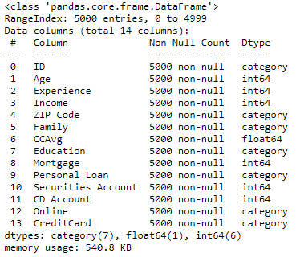
DATA CLEANING
CHECKING THE DATA TYPES OF VARIABLES AND FIXING THEM
DEPT. 4

Slide 7
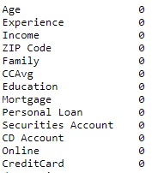
DATA CLEANING
DROPPING UNNECESSARY COLUMNS
REMOVING NEGATIVE VALUES FROM EXPERIENCE COLUMN
CHECKING NULL VALUES
DEPT. 4

Slide 8
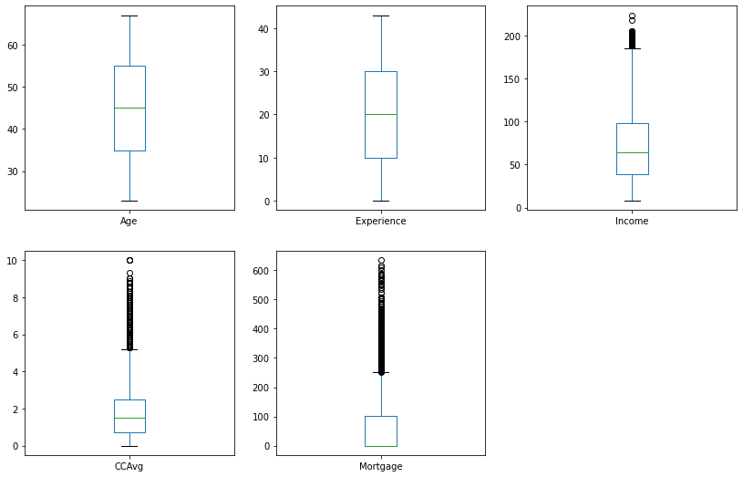
DATA CLEANING
OUTLIER DETECTION FOR CONTINOUS VARIABLES
DEPT. 4

Slide 9
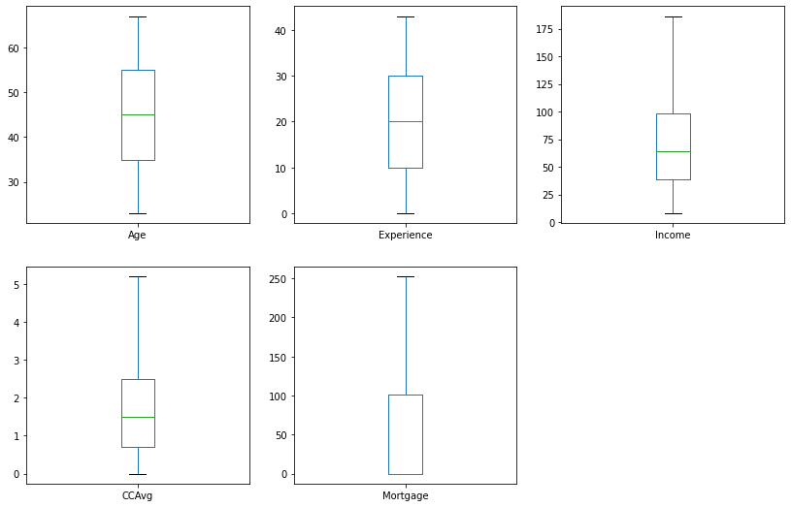
DATA CLEANING
REMOVING OUTLIERS BY CAPPING METHOD
DEPT. 4

Slide 10
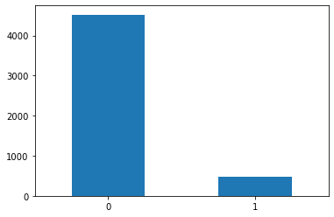
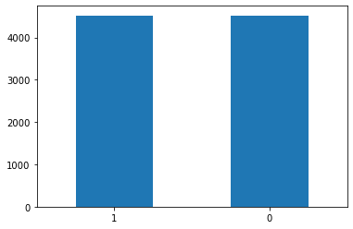
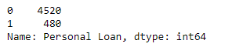
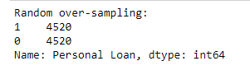
DATA CLEANING
CHECKING THE IMBALANCE IN THE DATASET
FIXING IT WITH RANDOM OVER SAMPLING METHOD
DEPT. 4

Slide 11
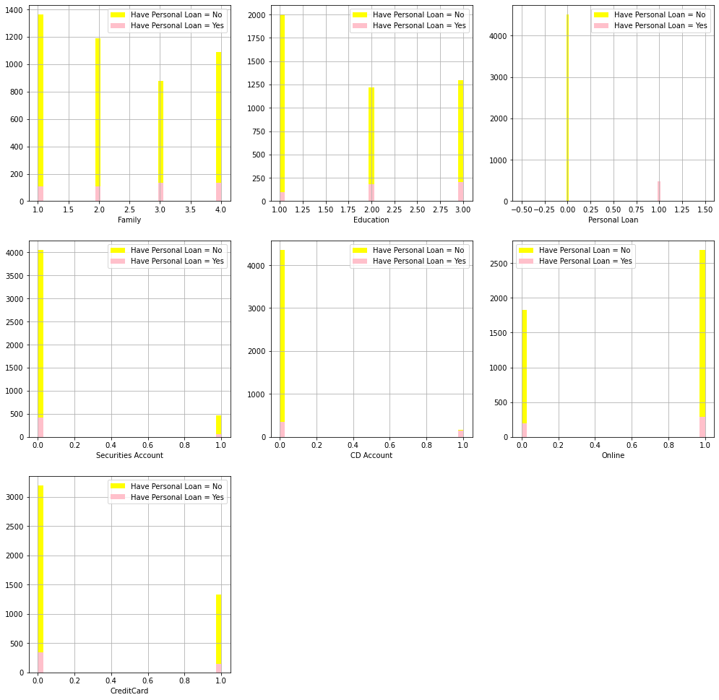
DATA DISCOVERY : EDA
TO UNDERSTAND THE IMPACT OF ALL THE CONTINOUS VARIABLES ON THE TARGET VARIABLE
DEPT. 4

Slide 12
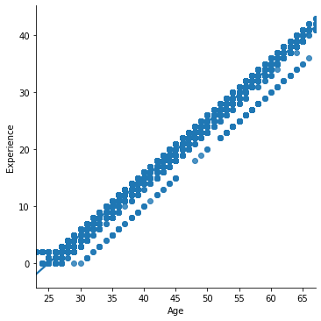
DATA DISCOVERY : EDA
MULTICOLINEARITY CHECK AND FIXING IT
DEPT. 4

Slide 13
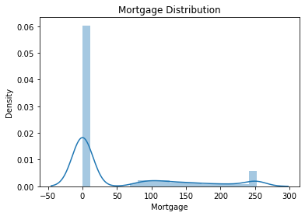
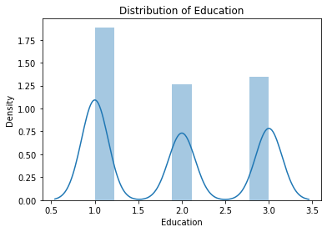
DATA DISCOVERY : EDA
UNDERSTANDING THE DISTRIBUTION OF NUMBERICAL VALUES IN COLUMNS MORTGAGE AND EDUCATION
DEPT. 4

Slide 14
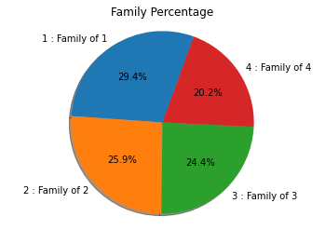
DATA DISCOVERY : EDA
TO GET THE PERCENTAGE OF CUSTOMERS WITH RESPECT TO COUNT OF FAMILY MEMBERS
DEPT. 4

Slide 15
DATA MODELLING : TRAIN TEST SPLIT
IMPORTING NECESSARY LIBRARIES
STORING FEATURE VARIABLES IN X
STORING TARGET VARIABLE IN Y
SPLITTING THE DATA INTO 80% TRAIN 20% TEST
DEPT. 4

Slide 16
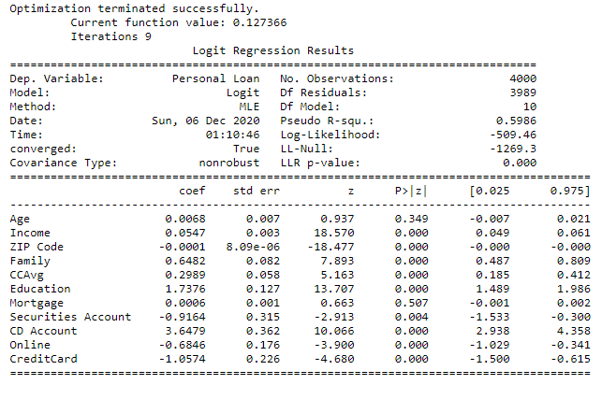
DATA MODELLING : LOGISTIC REGRESSION MODEL SUMMARY
DEPT. 4

Slide 17
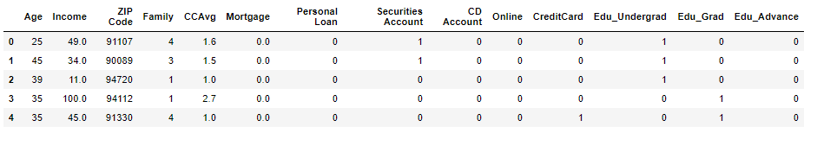
DATA OPTIMAZTION : FEATURE ENGINEERING
CREATED DUMMY COLUMNS FOR EDUCATION FEATURE
DEPT. 4

Slide 18
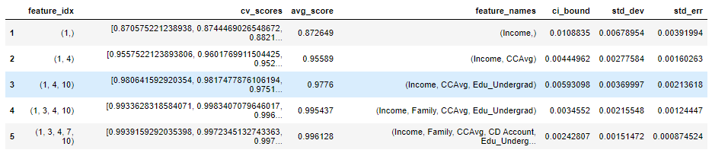
DATA OPTIMIZATION : FEATURE SELECTION
FORWARD SELECTION
BACKWARD SELECTION
RESULTS:
DEPT. 4

Slide 19
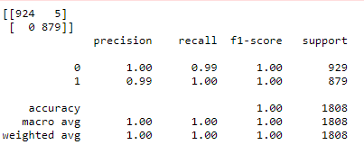
DATA OPTIMIZATION : RANDOM FOREST CLASSIFIER
ACCURACY: 98%
TRAINING TIME: 0.61 SECONDS
CONFUSION MATRIX:
DEPT. 4

Slide 20
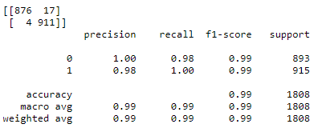
DATA OPTIMIZATION : GRADIENT BOOSTING CLASSIFIER
ACCURACY: 98%
TRAINING TIME: 1.12 SECONDS
CONFUSION MATRIX:
DEPT. 4

Slide 21
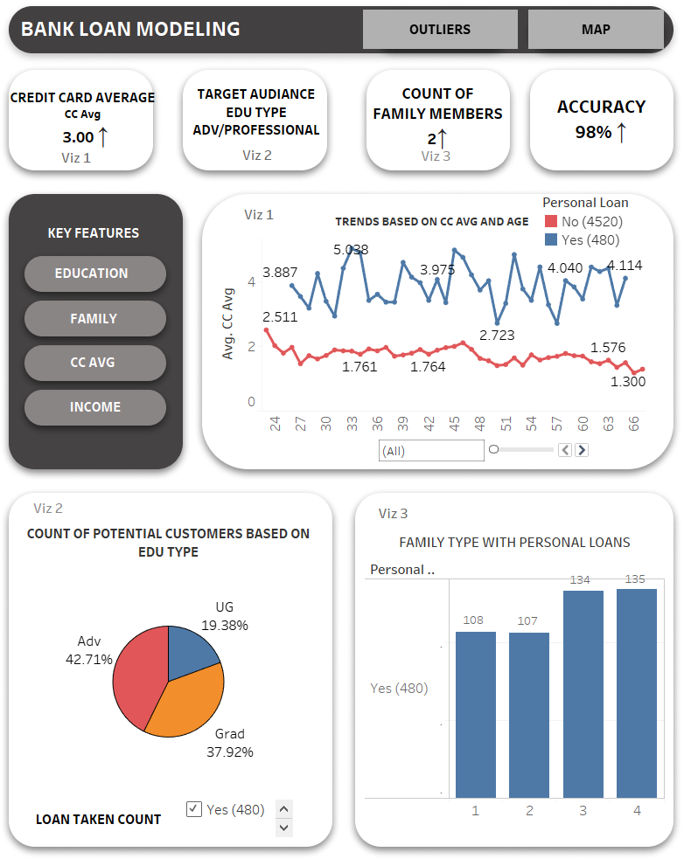
DATA STORYTELLING : DASHBOARD
DEPT. 4

Slide 22
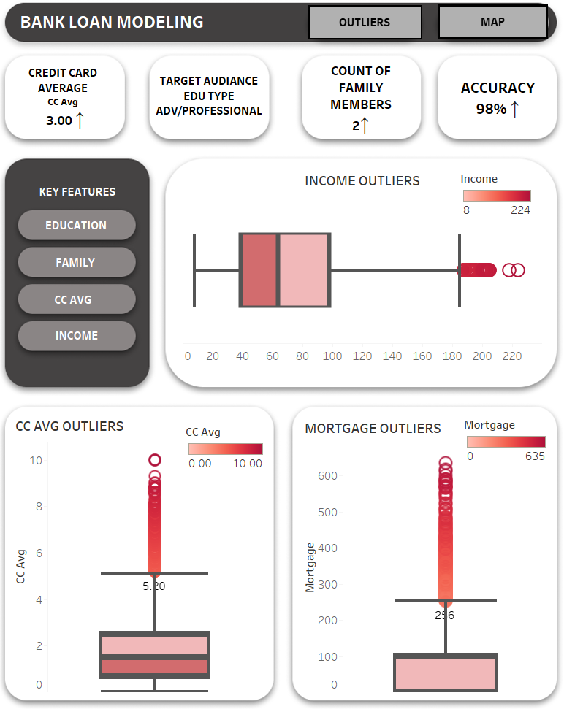
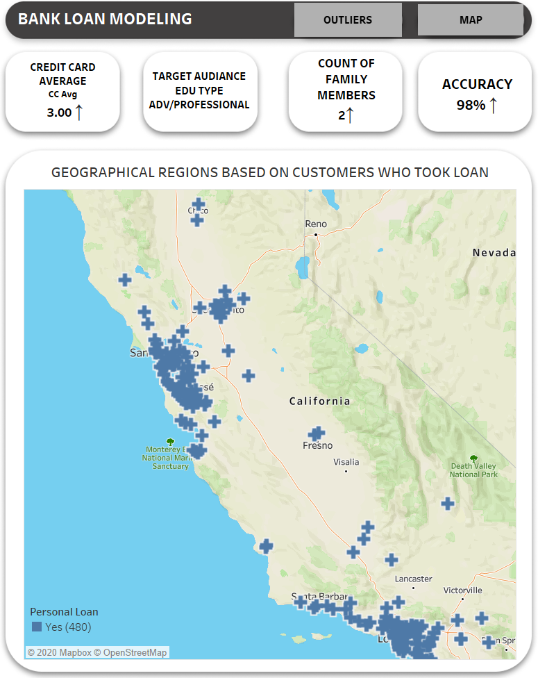
DATA STORY TELLING : DASHBOARD
DEPT. 4

Slide 23
CONCLUSION
Top features after feature selection: Education, Family, CCAvg, CD Account and Income.
Best Model to be used : Random Forest.
Accuracy and Training time: 98% and 0.61 respectively.
Random Forest models works better for classification problems.
Random Forest models are preferred in Banking sectors.
KPI’s:
Customers with Credit card avg more than 3
Family members more than 2.
Customers holding advance degrees.
Major Cities and Metropolitan areas of California

Slide 24
REFERENCES
Dataset : https://www.kaggle.com/itsmesunil/bank-loan-modelling
[1] R. Parmar, “Demystifying Optimizations for machine learning,” Medium, 05-Sep-2018. [Online]. Available: https://towardsdatascience.com/demystifying-optimizations-for-machine-learning-c6c6405d3eea. [Accessed: 16-Nov-2020]
[2] https://northeastern.instructure.com/courses/33355/files/5418529?module_item_id=4325658
[3] Dansbecker, “Using Categorical Data with One Hot Encoding,” 22-Jan-2018. [Online]. Available: https://www.kaggle.com/dansbecker/using-categorical-data-with-one-hot-encoding. [Accessed: 16-Nov-2020]
B. Ravichandran, “Visualize Geographical Data Using Maps in Dashboards,” 05-Oct-2020. [Online]. Available: https://www.boldbi.com/blog/visualize-geographical-data-using-map-dashboard. [Accessed: 22-Nov-2020]

Slide 25
THANK YOU!

